Slide 1

Purdue | Meijer
Progress Update Deck – 08-Mar-2024

Slide 2


Feature Addition
Adding new features centering Household Demographics
List of Features
Geographical
Nearby Places
Latitude
Longitude
City
State
County
Census Tract Code
Census Block Code
Metro/Micro Statistical Area Type
Traffic Features

Slide 3
Feature Addition
Adding new features centering Household Demographics
List of Features
Household Demographics
Economic
Features
Total Households
Median Household Income
Household Income Buckets- Under 50k, 50k – 100k, 100k – 200k & Above 200k
Median Age
Total Population
Housing Value Buckets – Under 100k, 110k – 250k, 250k – 500k & Above 500k
Male/Female Age: Population Buckets – Under 15, 15 to 64, Above 64

Slide 4
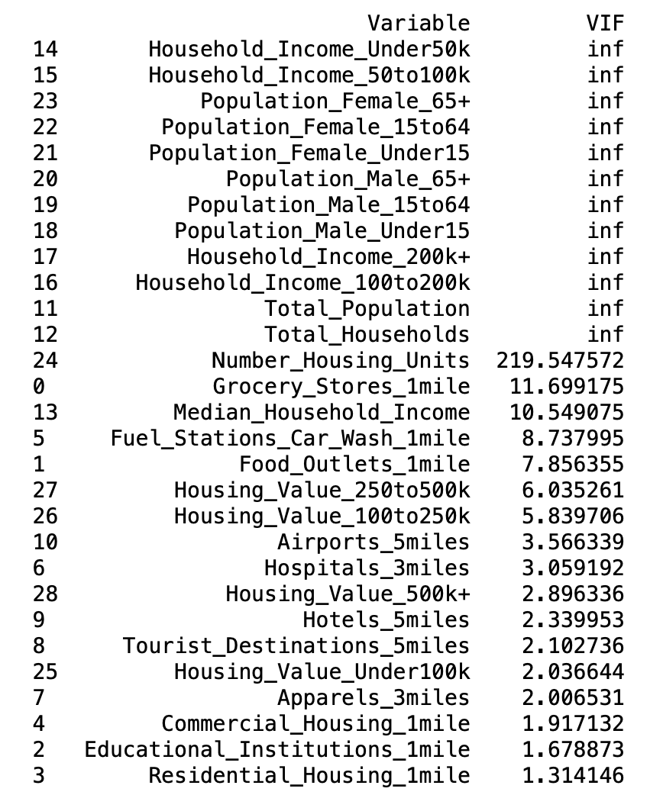
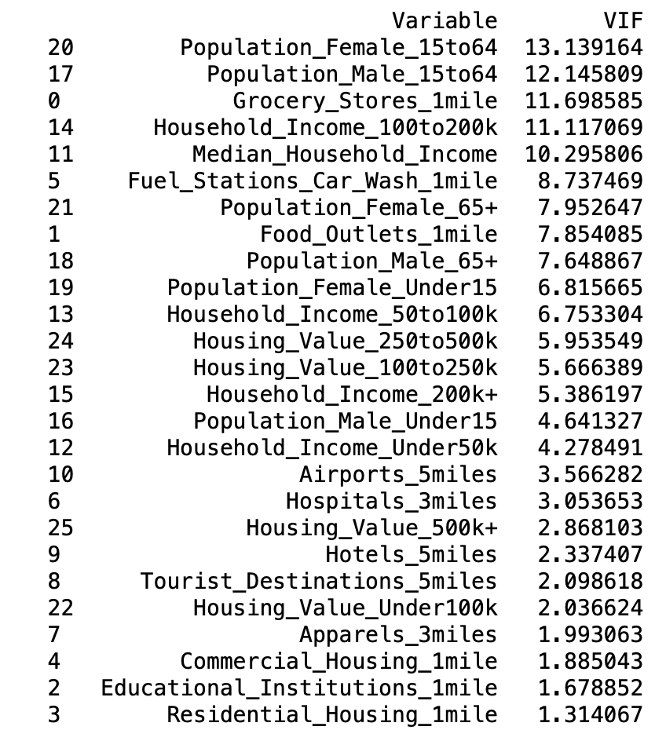

Data Preprocessing | Multicollinearity Check
Dropping columns with high VIF
Before
After
All the features have been scaled using Standard Scaler separately for test and train dataset

Slide 5
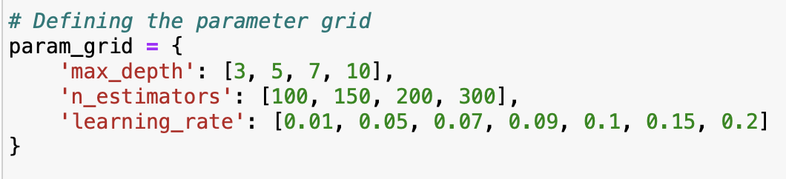
Data modelling | XG Boost Regressor
Train/Test Split -> 80:20
GridSearch CV: It's adept at handling the volatility and complexity of crypto markets
Standard Scalar used to perform Scaling
Competitor
Meijer
Both Comp. & Meijer

